Slide 1


Crossing Paths: Comparing King Rail Populations
Slides have animations
Carol Gause and Megan Linke
Population Genomics
Final Project

Slide 2
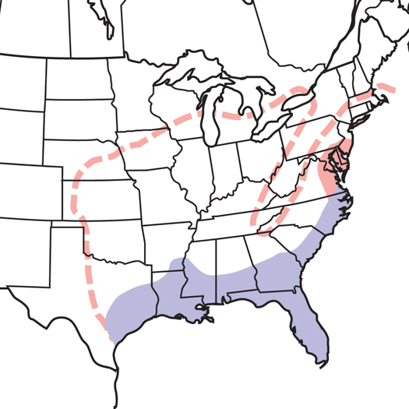
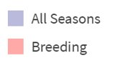
Comparing three geographically separate populations
Winous Point Marsh
Separated by location and migratory status
Migration = gene flow?
Not all rails migrate
Mackay Island NWR
Freddie Black Choctaw West WMA
All seasons
Breeding
Notes:
Ohio - Winous Point Marsh Migrating population
Mackay Island NWR (Resident)
Freddie Black Choctaw West WMA (Resident)

Slide 3
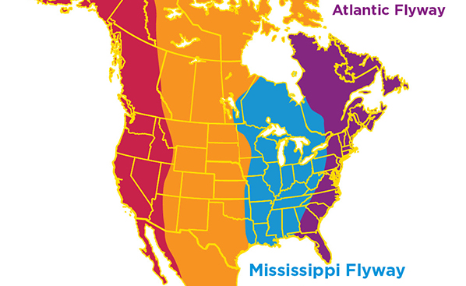
Migration Routes
Appalachian Mountains

Slide 4
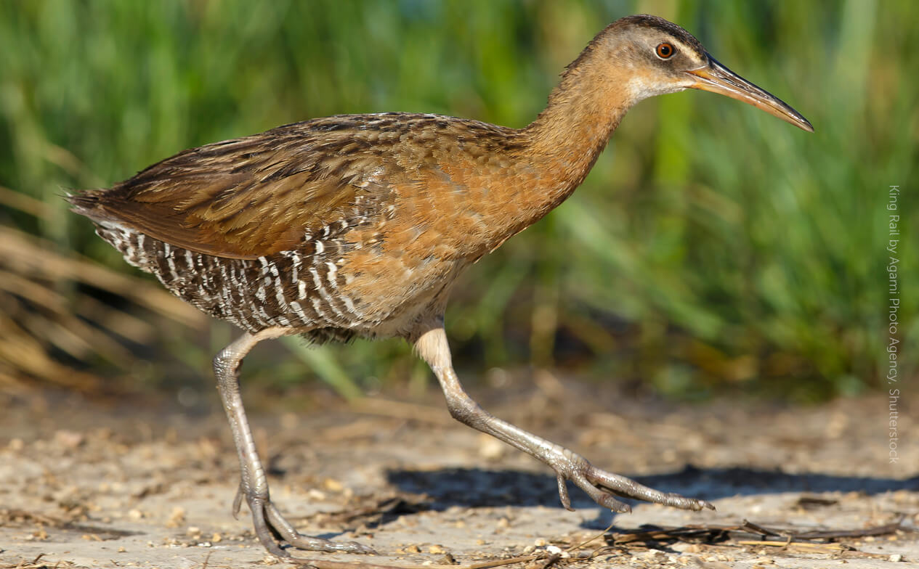
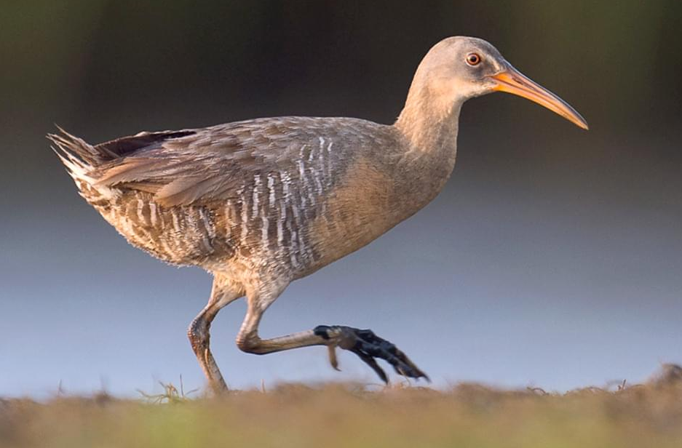
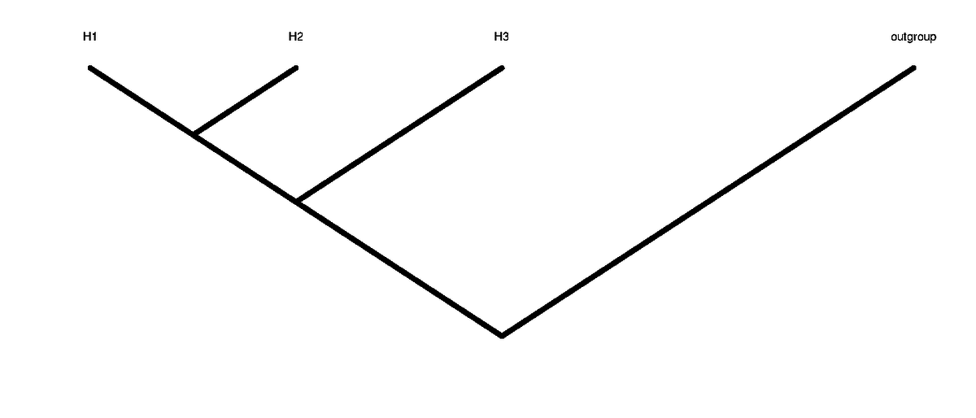
H1 H2 H3 H4
A B B A
B A B A
(nABBA-nBABA)
(nABBA+nBABA)
= Patterson's D (ABBA-BABA statistic)
Notes:
(nABBA-nBABA)/(nABBA+nBABA) -> how D stat is calculated

Slide 5
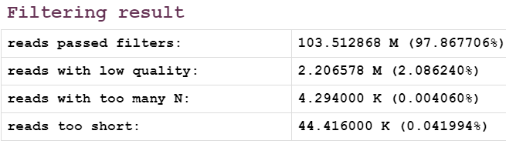
Step 1: Preprocessing using fastp
Forward reads
Filtered & trimmed forward & reverse fastq files
fastp
Reverse reads
Quality reports

Slide 6
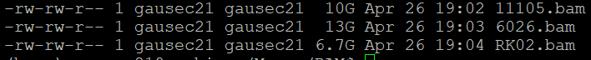
Step 2: Mapping
King rail fastq files
Burrows-Wheeler Aligner (BWA)
Sort the aligned reads (SAMtools)
Aligned & sorted bam file
Index clapper rail reference genome
Clapper rail reference genome
AR
OH
NC
Notes:
I am using the Burrows-Wheeler Aligner (BWA), a software tool commonly used for short read alignment to a reference genome. I will be using a high quality clapper rail genome (Rallus crepitans) to align 57 king rail (Rallus elegans) whole genomes. These species are sister taxa.

Slide 7
Step 3: ABBA-BABA test
Clapper rail reference genome
ABBA-BABA test (ANGSD)
D-statistic
Z score
Jackknife (R)
3 population​ representatives
Individual population representatives were chosen carefully:
All females
~1 year sample window
Sampled during the breeding season
Resident population individuals are confirmed residents
Notes:
I am using the Burrows-Wheeler Aligner (BWA), a software tool commonly used for short read alignment to a reference genome. I will be using a high quality clapper rail genome (Rallus crepitans) to align 57 king rail (Rallus elegans) whole genomes. These species are sister taxa.

Slide 8
OH
NC
AR
Outgroup
Winous Point Marsh
Mackay Island NWR
Freddie Black Choctaw West WMA
All seasons
Breeding
OH NC AR
AR NC OH
AR OH NC
Notes:
(nABBA-nBABA)/(nABBA+nBABA) -> how D stat is calculated
Positive D-statistic means that H2 is closer to H3 than to H1
Negative D-Statistic means that H1 is closer to H3 than to H2
Any Z score above |3| is considered to be a significant

Slide 9
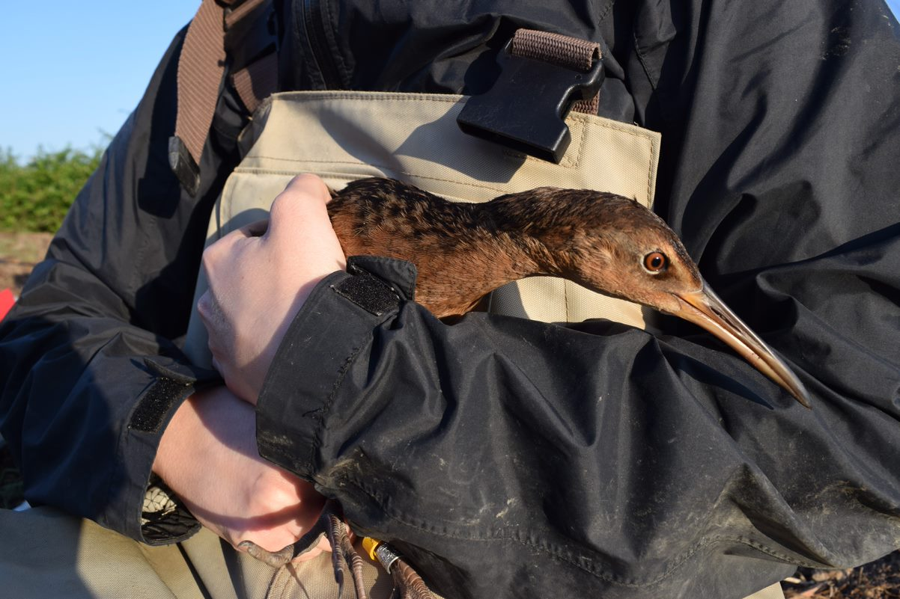
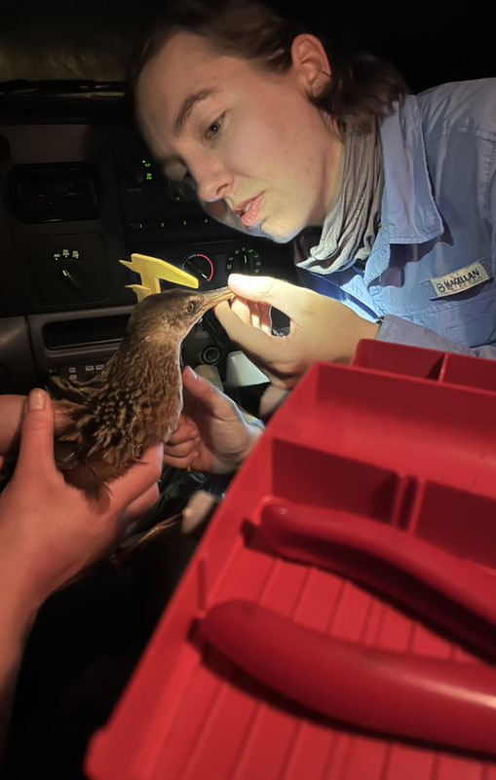
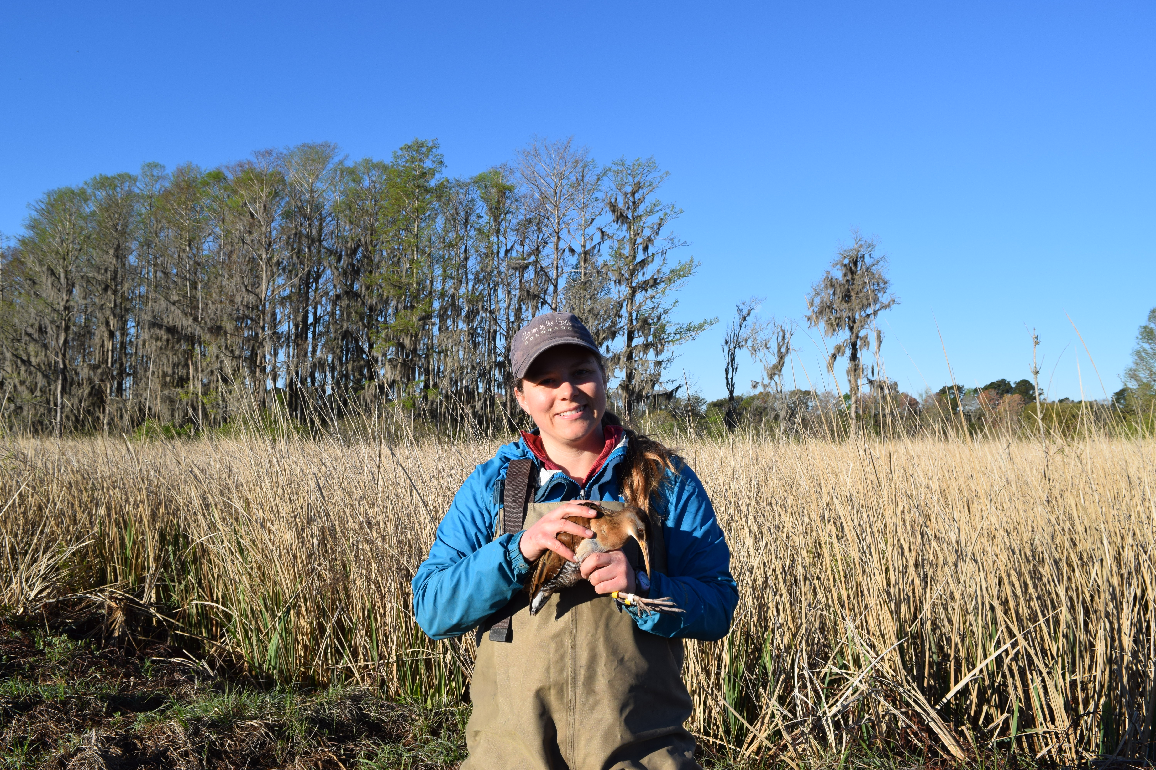
Questions?
Future Directions
More analyses
Admixture
Population-level genetic diversity
Is there a migration gene?
Notes:
Since king rails are a threatened species, we are interested in estimating overall population size, structure, connectivity, and levels of diversity. We can do this by safely catching and sampling the DNA of a few individual rails across the range. The naturally occurring genetic variation can help us understand adaptation potential. I used whole genome sequencing: so I have the entire set of DNA of each bird in my samples.

